Slide 1
Structured Query Language(SQL)
Structured Query Language (SQL)
Language to query a relational database.
•Structured English Query Language (Sequel) developed by IBM.
•Later it is known as Structured Query Language.
•Different Versions :SQL-86,SQL-89,SQL-92, SQL-2003,SQL-2006,SQL -2008
•Not Case sensitive.
Multiline statements; each statement ends with a semicolon.

Slide 2

s
oCommands for database definition, modification and
deletion.(DDL)
oEg: CREATE,ALTER,DROP
oSQL-Data-Manipulation Language (SQL-DML):
O Support for querying and modifying the database.
O Commands to insert, delete and modify tuples in the database.o
Eg: INSERT, SELECT, UPDATE, DELETE.

Slide 3
Categories of Commands in SQL
oTransaction Control:
oCommands to specify the start and end of transactions.
oEg: COMMIT,ROLLBACK
oAuthorization:
oCommands for specifying access rights to relations and views.
oEg: GRANT, REVOKE

Slide 4
SQL-DDL
Allows users to
oTo define relation schema.
oThe domain of values of each attribute.
oThe integrity constraints.
oThe set of indices to be maintained for each relation.
oThe security and authorization information for each relation.
oThe physical storage structure of each relation on disk.

Slide 5
SQL-Basic Data Types
char(n): A fixed-length character string with length n.
varchar(n): A variable-length character string with maximum length n.
int: An integer
smallint: A small integer (subset of the integer type).
numeric(p, d): A fixed-point number with user-specified precision. (p-the total no. of digits and d-the no. of digits after the decimal point)
real, double precision: Floating-point and double-precision floating-point numbers with machine-dependent precision.
float(n): A floating-point number, with precision of at least n digits.
date: specifies year, month, date
time: in hours, minutes and seconds.

Slide 6
SQL- CREATE TABLE

Slide 7
SQL- DDL

Slide 8
Constraints
Constraints are
Primary Key
Foreign Key
not null
Unique
check(<predicate>)
Default
Constraints can be specified at
Column Level
Table Level

Slide 9
Primary Key Constraint
To uniquely describe rows in a table.
The value of P.K must be NOT Null and Unique.
Composite Primary Key
Column Level Constraint Table level Constraint
CREATE TABLE EMPLOYEE (EMP_ID varchar(9), EMP_NAME varchar(35) NOT NULL , AGE int, SALARY numeric(8,2) NOT NULL ,
PRIMARY KEY(EMP_ID));
CREATE TABLE EMPLOYEE (EMP_ID varchar(9) PRIMARY KEY, EMP_NAME varchar(35) NOT NULL , AGE int, SALARY numeric(8,2) NOT NULL);

Slide 10
Primary Key Constraint
Composite Primary Key
Multiple columns are used to specify the primary key of a table.
These columns may have different data types.
Syntax for composite key:
CREATE TABLE TABLE_NAME (COLUMN_1 DATA_TYPE_1, COLUMN_2 DATA_TYPE_2,….. PRIMARY KEY (COLUMN_1, COLUMN_2, …));
Eg: CREATE TABLE section (course id varchar (8), sec id varchar (8), semester varchar (6),year numeric (4,0),building varchar (15),room number varchar (7),time slot id varchar (4), PRIMARY KEY (course id, sec id, semester, year));
Note: Composite PK can be applied only at table level

Slide 11
Foreign Key Constraint
Place your Webcam Video here
Size 38%
Foreign Key
Indicates the relationship between two tables.
The value of F.K is derived from the P.K of the other table.
Referenced column and referencing column should have the same data type, size can be different
Column Level Constraint Table level Constraint
CREATE TABLE SKILL (Sl_No varchar(9) PRIMARY KEY, Emp_id varchar(10), , Skill varchar2(35), FOREIGN KEY(Emp_id) REFERENCES EMPLOYEE(EMP_ID));
CREATE TABLE SKILL (Sl_No varchar(9) PRIMARY KEY, Emp_id varchar(10) REFERENCES EMPLOYEE(EMP_ID), Skill varchar2(35));

Slide 12
Foreign Key Constraint
Ensures that the foreign key must be either null or it must have a matching primary key with which it is related.
Employee Department
EID | NAME | SALARY | DEPT_ID
100 | ANKIT | 25,000 | AA
200 | LALIT | 27,000 | CC
300 | AMBU | 30,000 | DD
400 | DEEPAK | 20,000 | EE
500 | SUMIT | 22,000 | BB
Dept_ID | Dept_Name
AA | Accounts
BB | Biotechnology
CC | Computer Science
EE | Electrical
This entry(DD) is not allowed as it is not present in the Dept_ID of relation Department

Slide 13
Not null Constraint
NOT NULL constraint
Restricts to enter null value to an attribute.
Null is default value for every attribute.
If attribute value is unknown or not meaningful.
Null value is inappropriate for certain attributes.
Eg: in Employee relation, employee Name and age must be NOT NULL.
Primary key of a relation schema cannot be null
In department relation, Dept_name is the primary key (must be NOT NULL)
Name varchar(20) not null
Salary numeric(8,2) not null

Slide 14
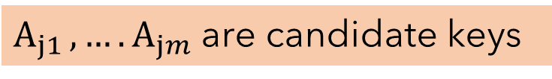
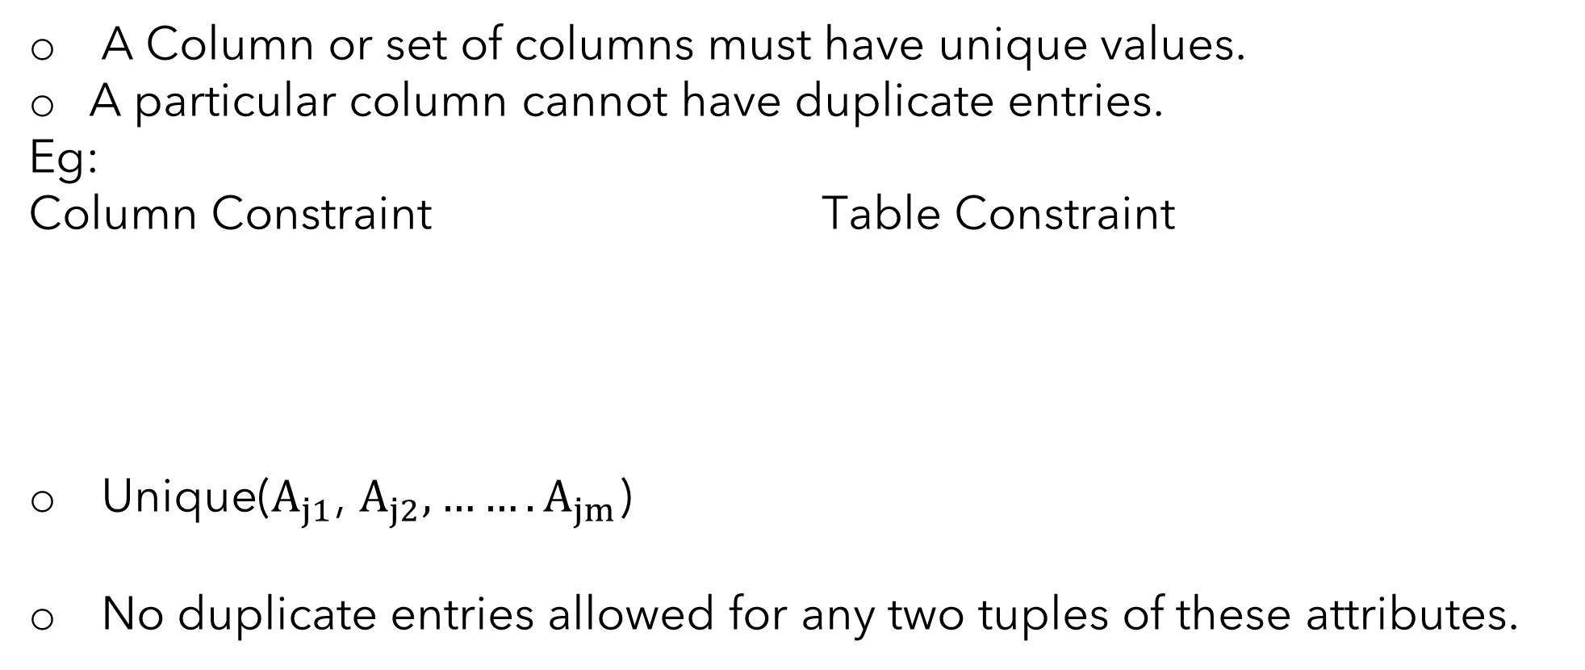
Unique Constraint
Unique constraint:
A Column or set of columns must have unique values.
A particular column cannot have duplicate entries.
Eg:
Column Constraint Table Constraint
Unique($A_{j1}$, $A_{j2},…….A_{jm}$)
No duplicate entries allowed for any two tuples of these attributes.
CREATE TABLE EMPLOYEE (EMP_ID varchar(9),
EMP_NAME varchar(35) NOT NULL ,
AGE int, SALARY numeric(8,2) NOT NULL,
CONSTRAINT EMP Unique(EMP_ID) );
CREATE TABLE EMPLOYEE (EMP_ID varchar(9),
EMP_NAME varchar(35) NOT NULL Unique,
AGE int, SALARY numeric(8,2) NOT NULL);
$A_{j1 },….A_{jm}$ are candidate keys

Slide 15
Check Constraint
Restricts the value of an attribute to a permitted range.
If apply check(p) to an attribute A.
The predicate p must be satisfied by the domains of the Attribute A.
In Employee relation, check(salary>0) ensure that salary is a positive value.
Check must be performed before storing data to the database.
CREATE TABLE EMPLOYEE (EMP_ID varchar(9),
EMP_NAME varchar(35) UNIQUE,
AGE int, SALARY numeric(8,2) NOT NULL CHECK(salary>0));

Slide 16
Default Constraint
Insert a default value to a column.
The default value will be added to all new records, if no other value is specified.
Eg: Assigns default value to “State “ column when person table is created.
CREATE TABLE PERSON (ID varchar(9),
NAME varchar(35) NOT NULL ,
AGE int,
STATE varchar(9) DEFAULT ‘KERALA’);

